Slide 1



PHOTOGRAPHS
84th Annual Session of the Indian Ceramic Society
72nd Annual Session of All India Pottery Manufacturers’ Association
46th Annual Session of Indian Institute of Ceramics
And
National Seminar on “Propelling Innovations in Glass And Ceramics For Atmanirbhar Bharat”
Organized by
Indian Ceramic Society, Kolkata Chapter
In association with
CSIR-Central Glass & Ceramic Research Institute
During
10-12 December, 2020

Slide 2
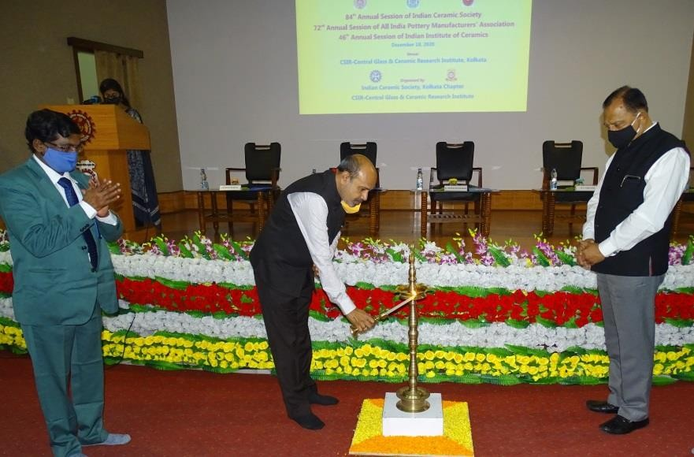
Inaugural Session
LIGHTENING OF LAMP
Lightening of Lamp by Dr K. Muraleedharan, President, InCerS during inaugural session.

Slide 3
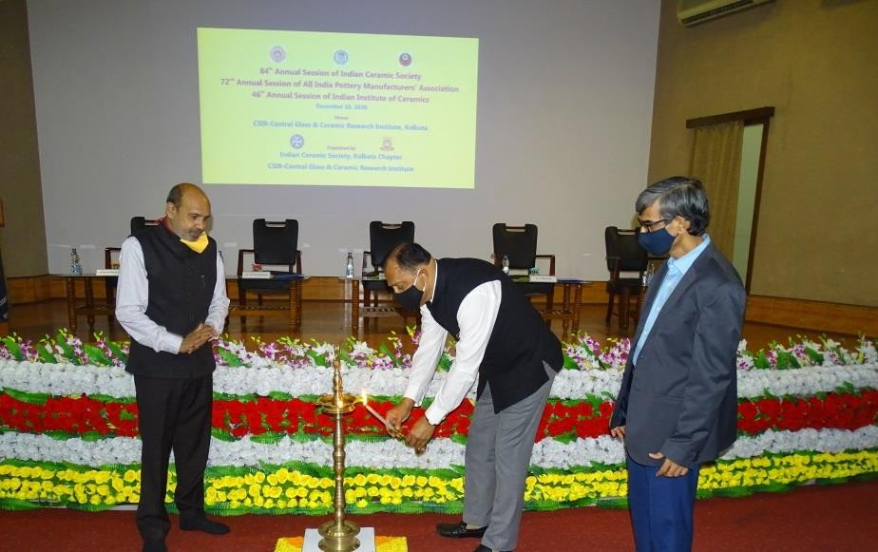
Inaugural Session
LIGHTENING OF LAMP
Lightening of Lamp by Dr A. K. Chattopadhyay, President, AIPMA during inaugural session.

Slide 4
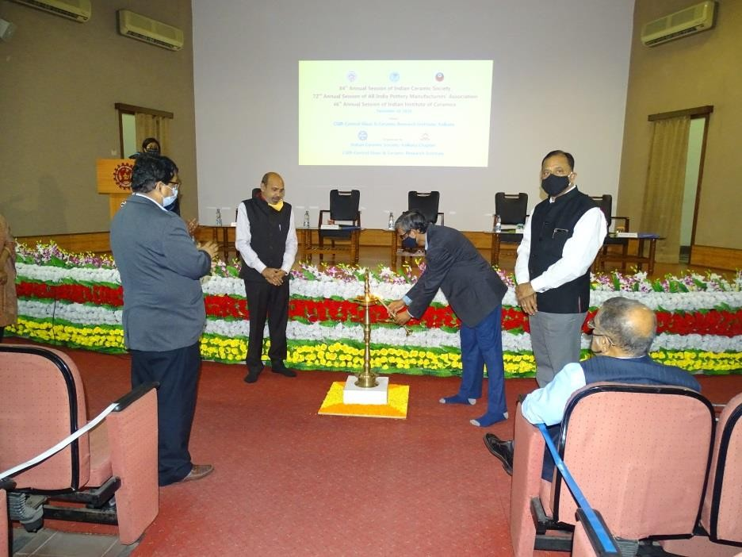
Inaugural Session
LIGHTENING OF LAMP
Lightening of Lamp by Dr H. S. Tripathi, Vice-President, IIC during inaugural session

Slide 5
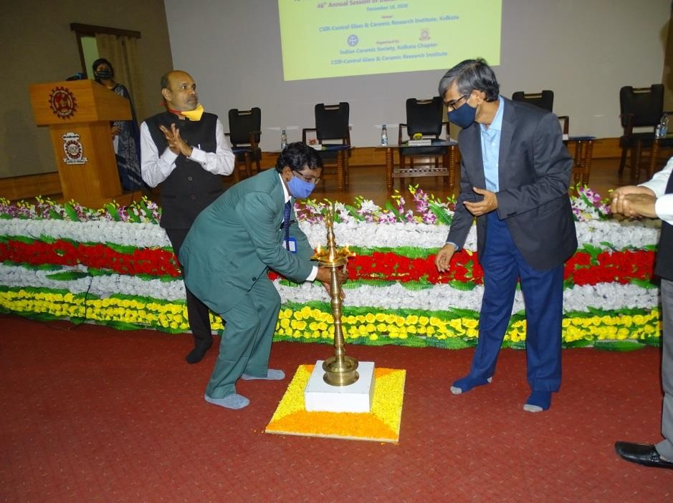
Inaugural Session
LIGHTENING OF LAMP
Lightening of Lamp by Mr Sitendu Mandal, Chairman of the Organizing Committee during inaugural session.

Slide 6
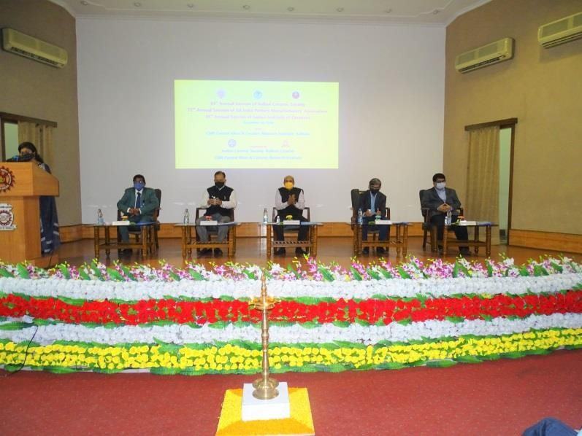
FELICITATION OF THE DIGNITARIES
Dignitaries on the Dais

Slide 7
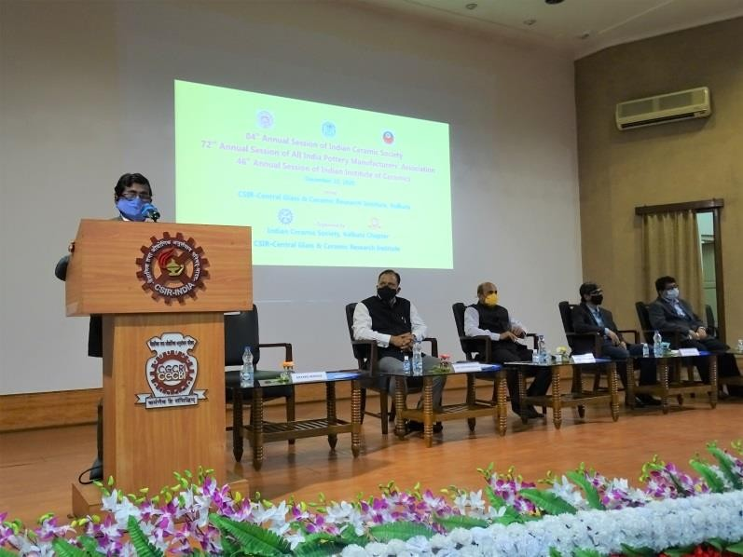
FELICITATION OF THE DIGNITARIES
Welcome Address by Mr Sitendu Mandal, Chairman, Organizing committee.

Slide 8
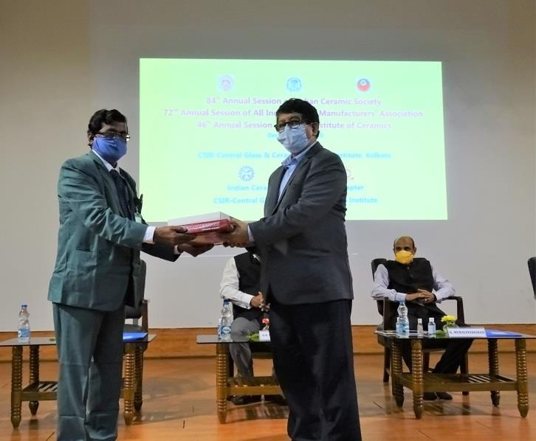
FELICITATION OF THE DIGNITARIES
Dr Dipayan Sanyal, Director (Officiating), CSIR-CGCRI felicitated by Mr Sitendu Mandal, Chairman of the Organizing Committee.

Slide 9
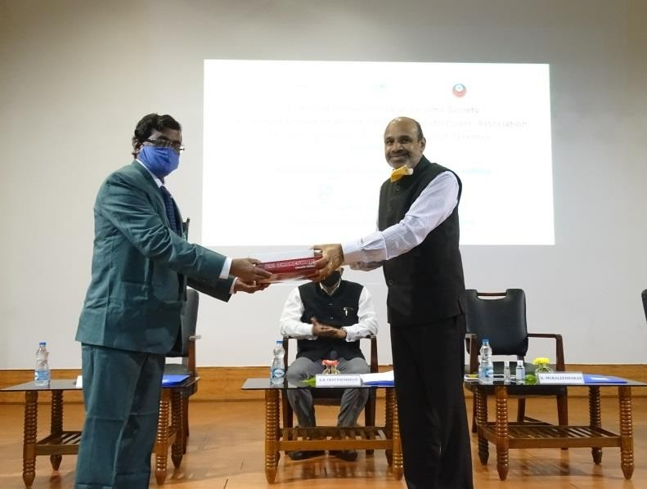
FELICITATION OF THE DIGNITARIES
Dr K. Muraleedharan, President, InCerS felicitated by Mr Sitendu Mandal, Chairman, Org. Comm.

Slide 10
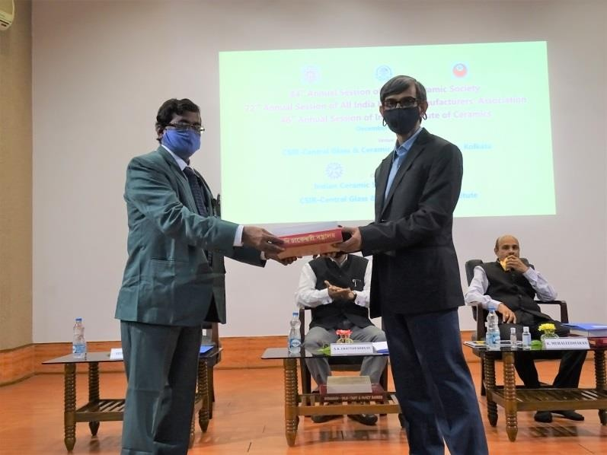
FELICITATION OF THE DIGNITARIES
Dr H.S.Tripathi, Vice President, IIC felicitated by Mr Sitendu Mandal, Chairman, Org. Comm.

Slide 11
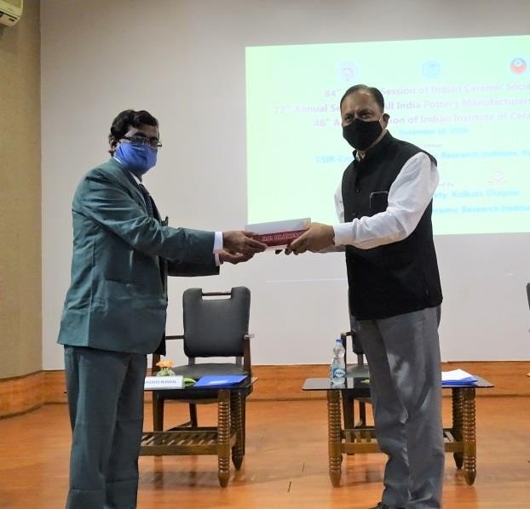
FELICITATION OF THE DIGNITARIES
Dr Arup Kumar Chattopadhyay, President, AIPMA felicitated by Mr Sitendu Mandal, Chairman, Org. Comm.

Slide 12
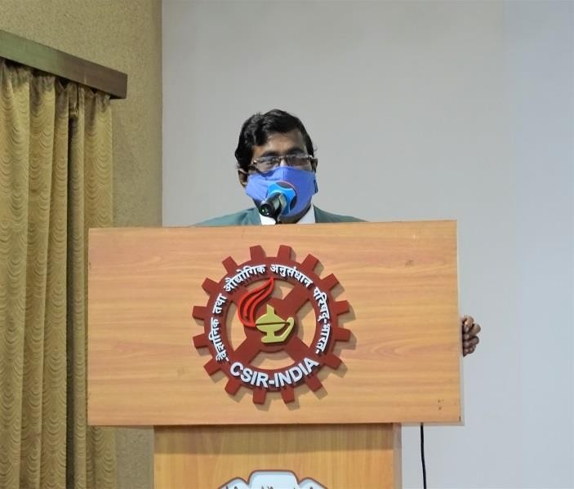
Address by Mr Sitendu Mandal, Chairman, Organizing Committee

Slide 13
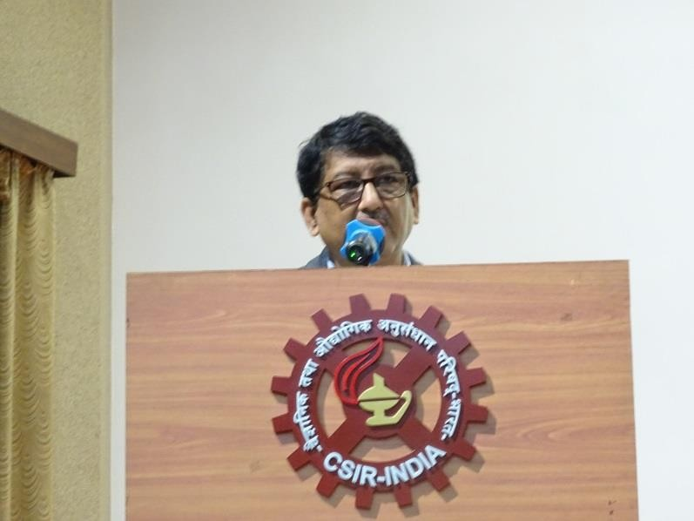
Address by Dr Dipayan Sanyal, Director (Officiating), CSIR-CGCRI

Slide 14
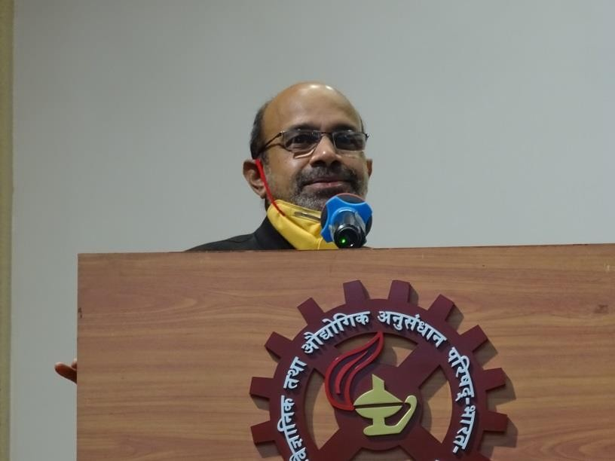
PRESIDENTIAL ADDRESSES
Presidential Address by Dr. K Muraleedharan, President, InCerS

Slide 15
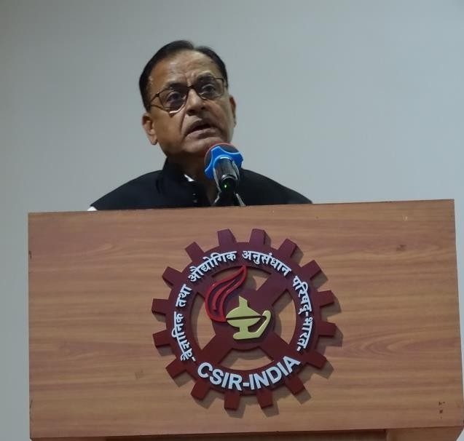
PRESIDENTIAL ADDRESSES
Presidential Address by Dr. Arup Kumar Chattopadhyay, President, AIPMA

Slide 16
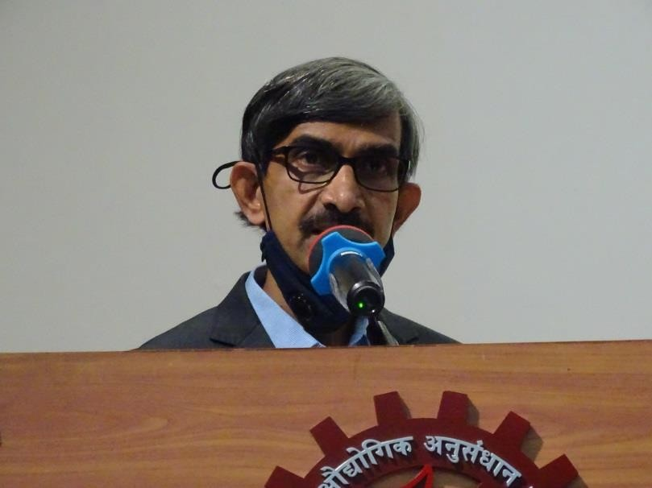
PRESIDENTIAL ADDRESSES
Presidential Address by Dr H S Tripathi, Vice President, IIC

Slide 17
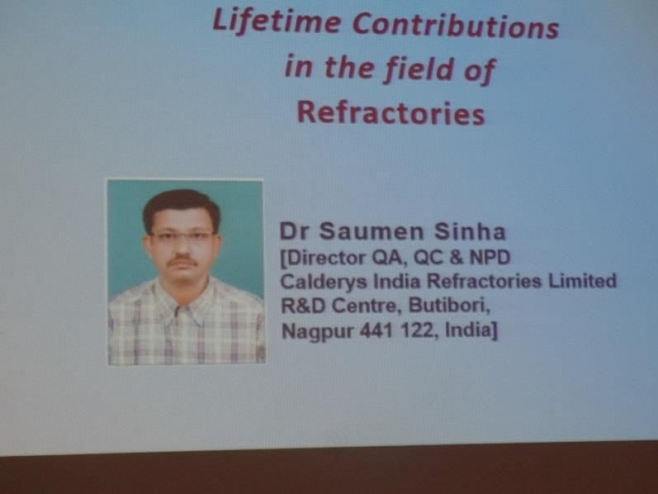
PRESENTATION OF AWARDS OF INCERS
Dr Saumen Sinha, Recipient of Refractory Technologist Award (2020)

Slide 18
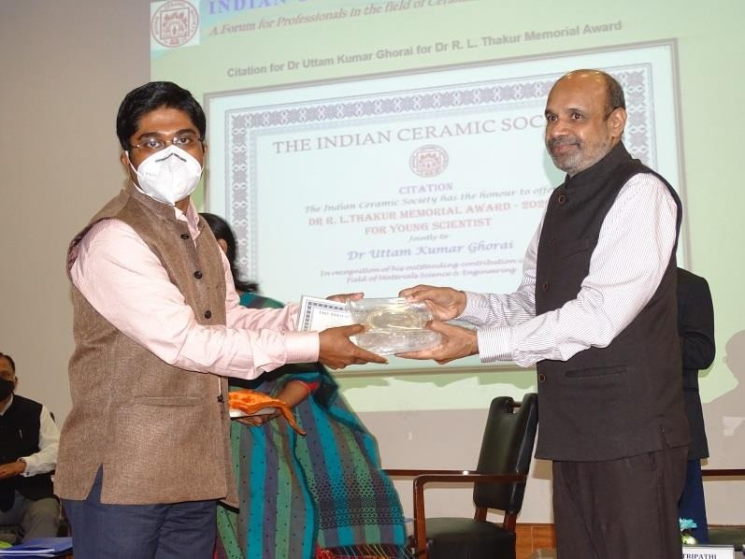
PRESENTATION OF AWARDS OF INCERS
Dr Uttam Kumar Ghorai, one of the Recipients of Dr R. L. Thakur Memorial Award (2020) accepting award from Dr K. Muraleedharan, President, InCerS

Slide 19
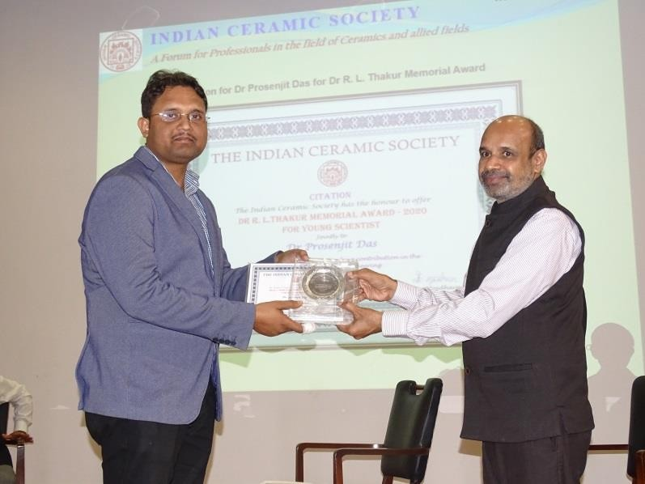
PRESENTATION OF AWARDS OF INCERS
Dr Prosenjit Das, one of the Recipients of Dr R. L. Thakur Memorial Award (2020), accepting award from Dr K. Muraleedharan, President, InCerS

Slide 20
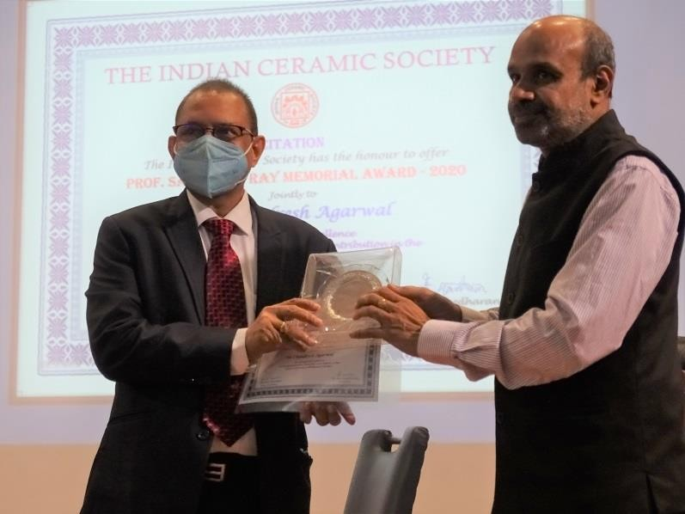
PRESENTATION OF AWARDS OF INCERS
Dr Chandresh Agarwal, one of the Recipients of Prof. Sasadhar Ray Memorial Award (2020), accepting award from Dr K. Muraleedharan, President, InCerS

Slide 21
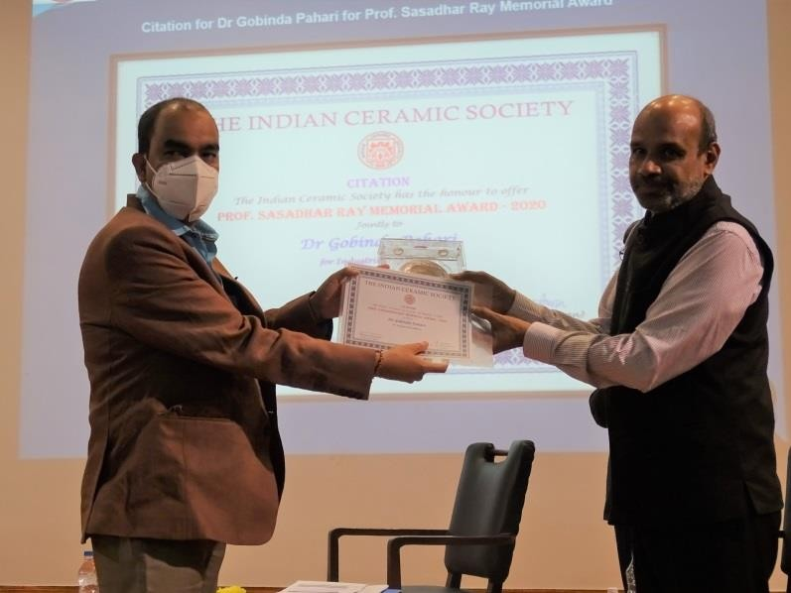
PRESENTATION OF AWARDS OF INCERS
Dr Gobinda Pahari, one of the Recipients of Prof. Sasadhar Ray Memorial Award (2020), accepting award from Dr K. Muraleedharan, President, InCerS

Slide 22
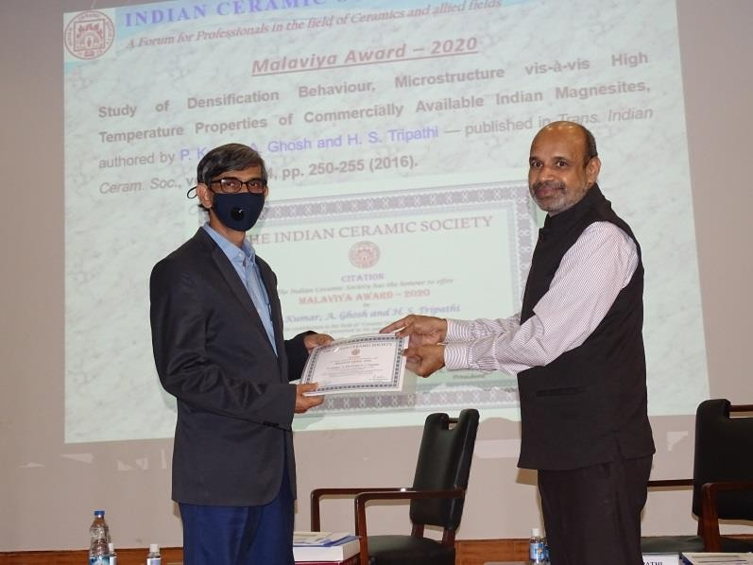
PRESENTATION OF AWARDS OF INCERS
Dr H. S. Tripathi, receiving Malaviya Award (2020) for his paper, “Study of Densification Behaviour, Microstructure vis-à-vis High Temperature Properties of Commercially Available Indian Magnesites”, from Dr K. Muraleedharan, President, InCerS.

Slide 23
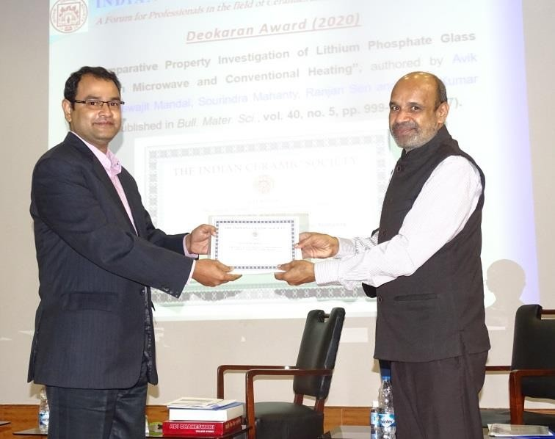
PRESENTATION OF AWARDS OF INCERS
Dr Ashis Kumar Mandal receiving Deokaran Award (2020) for his paper, “A Comparative Property Investigation of Lithium Phosphate Glass Melted in Microwave and Conventional Heating”, from Dr K. Muraleedharan, President, InCerS.

Slide 24
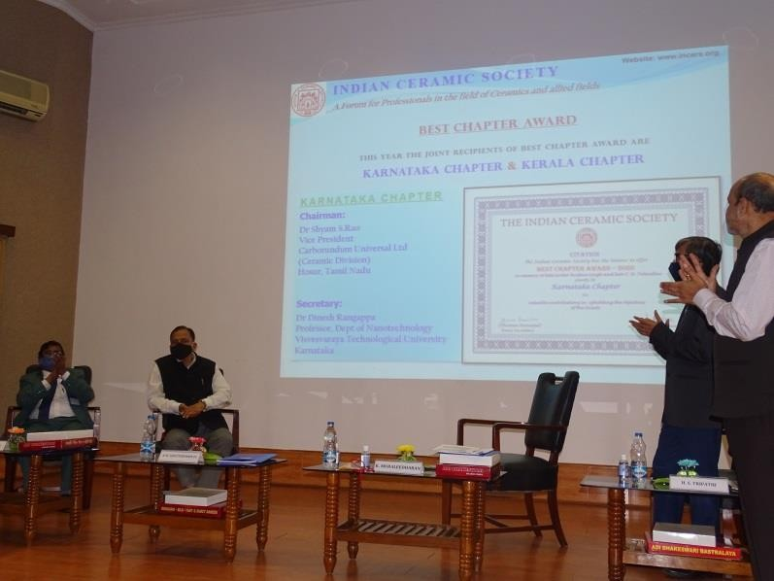
PRESENTATION OF AWARDS OF INCERS
Announcement of Best Chapter Award (2020) — (i) Karnataka Chapter and (ii) Kerala Chapter

Slide 25
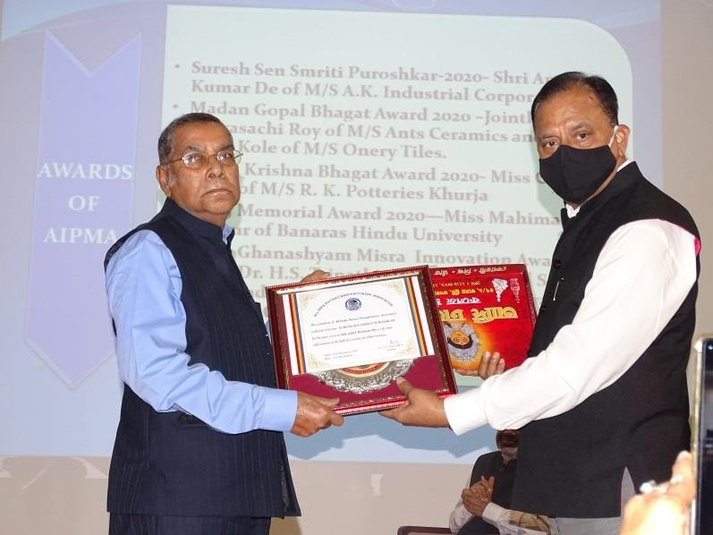
PRESENTATION OF AWARDS OF AIPMA
Suresh Sen Smriti Puroshkar- Shri Amit Kr. De of A.K. Industrial Corp.

Slide 26
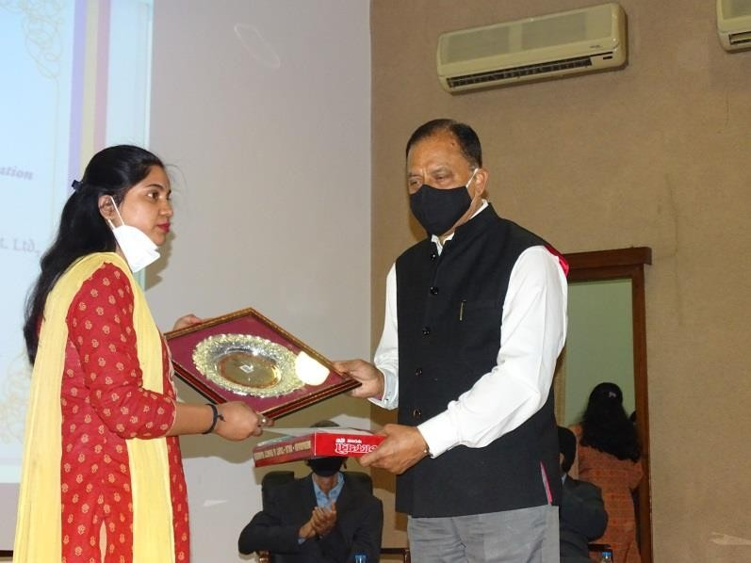
PRESENTATION OF AWARDS OF AIPMA
G.K. Bhagat Memorial Award– Miss Champa Garai of R K Potteries

Slide 27
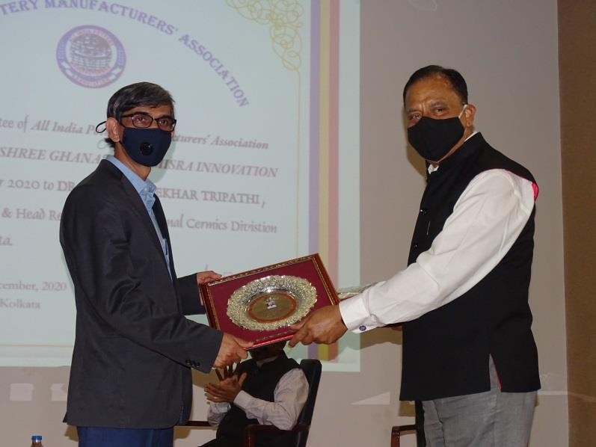
PRESENTATION OF AWARDS OF AIPMA
Ghanshyam Misra Innovation Award- Dr H.S. Tripathi (CSIR-CGCRI, Kolkata)

Slide 28
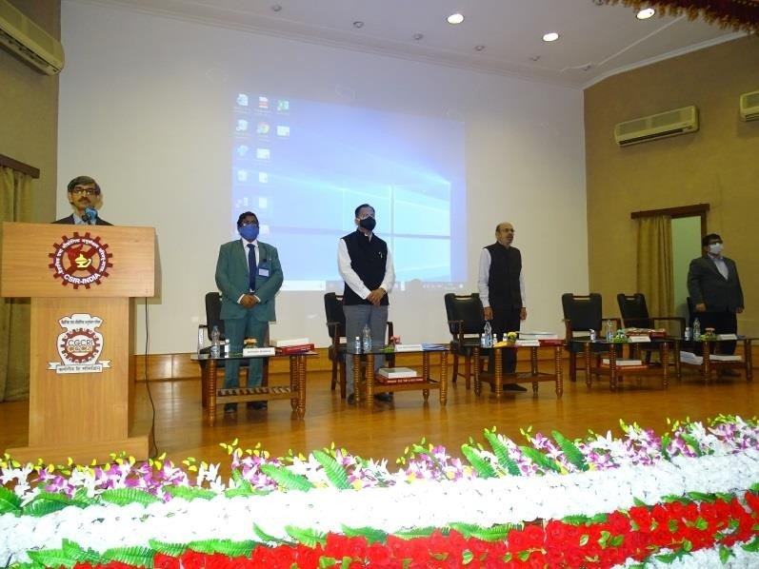
NATIONAL ANTHEM
Dignitaries on the Dais during the National Anthem

Slide 29
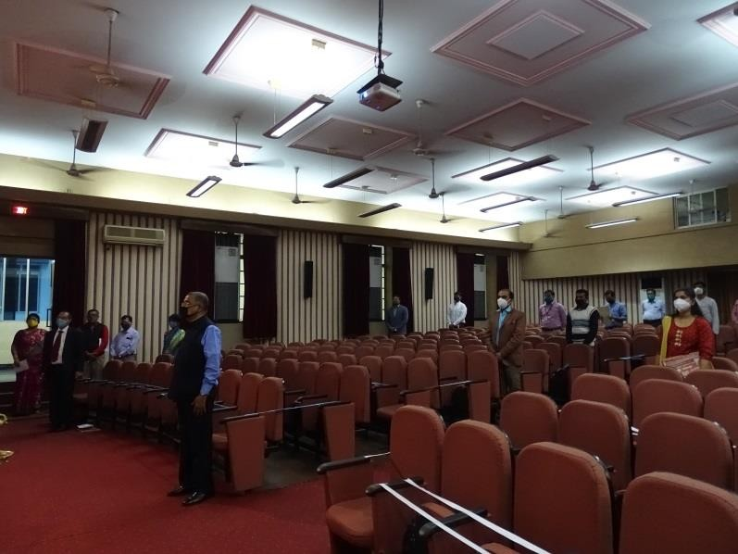
NATIONAL ANTHEM
A group of Audience during the National Anthem

Slide 30
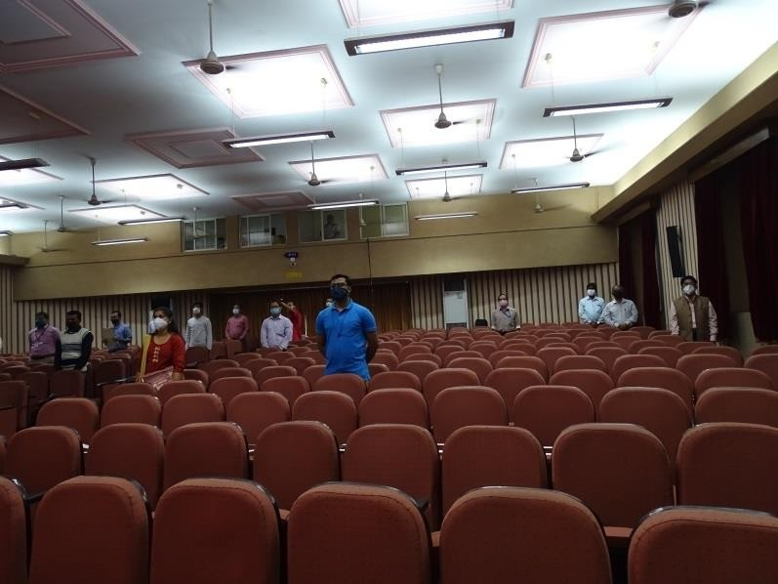
NATIONAL ANTHEM
A group of Audience during the National Anthem

Slide 31
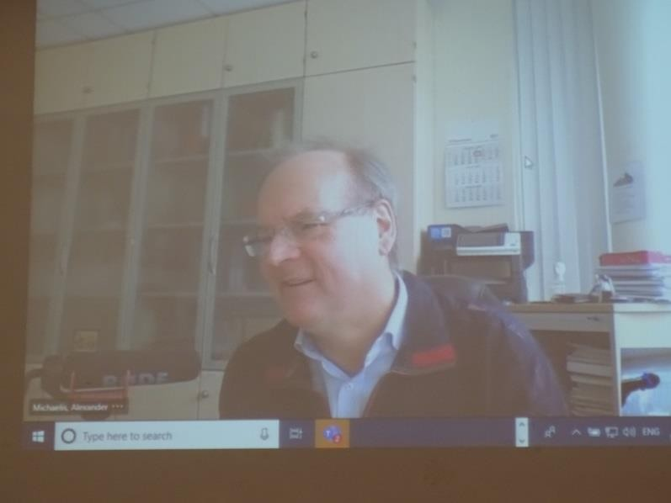
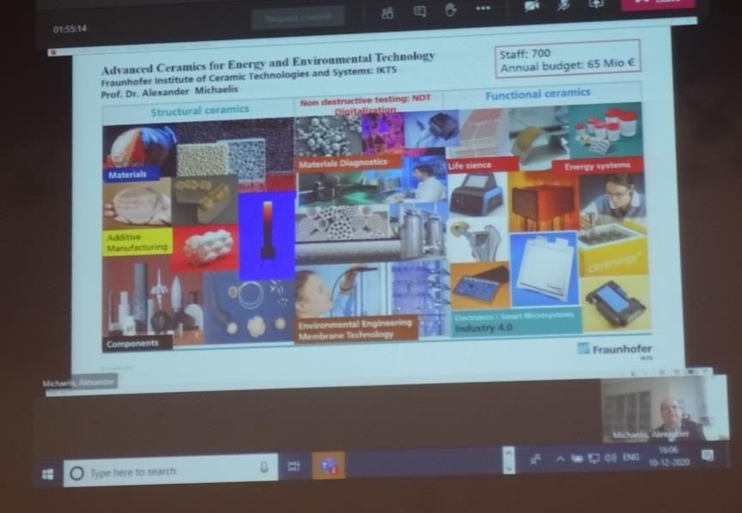
33RD M. G. BHAGAT MEMORIAL LECTURE
33rd M. G. Bhagat Memorial Lecture delivered by Professor Dr. rer. nat. habil. Alexander Michaelis, President of Fraunhofer Institute for Ceramic Technologies and Systems IKTS, Dresden, Germany and Full Professor at University of Dresden, in virtual platform on the topic, “Advanced Ceramics for Energy and Environmental Technology”.

